Slide 1
Ms. Poe’s Room 101
Everything you need to know and more!!

Slide 2
ENTER and EXIT
Entering the Classroom
Directions on the Projector Screen/Board Outside
Everyone will be seated and working
Daily Instructions
Reviewing homework with table groups
Turning in work
BE READY WHEN I WALK IN!
Exiting the Classroom
The clock does not dismiss you
Homework must be written down before exiting

Slide 3
LEAVING YOUR SEAT
Restroom Procedure
Restroom Pass
Frequency of Trips
Asking
Needing Supplies
Supply Boxes
Around the Room
Sharpening a Pencil
During Class
Getting Tissues/Trash
Don’t make a scene

Slide 4
Turning in Work
Homework
Basket for work
Start of the day
Not late
Heading on Paper
Name, Period, Date
Absent Work
Basket for work
Known Absences
Sick Work
Late Work
Basket
Lunch Time

Slide 5
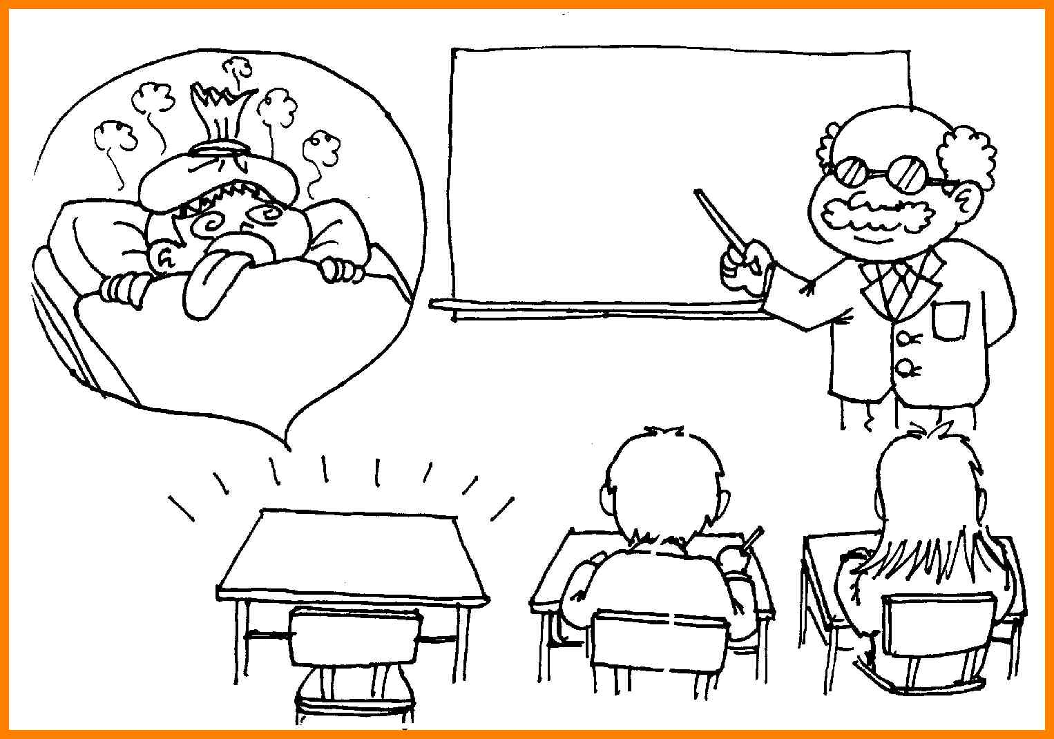
Absent Work
Where do I find my work?
Work Missed Folder
Returned Work Folder
Website
Where do I turn in my work?
Absent work basket
How long do I have to turn it in?
Length of absence
What if I know I’m going to be absent?
Getting work before you leave
Turning in work before you leave
Having work ready upon return

Slide 6
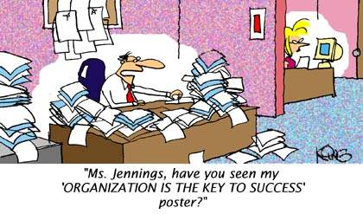
Staying Organized
Reading
Guided Notes
Reading Guides
Writing
Notes
Brainstorming
Exercises
Grammar
Notes
Practice Sheets
Vocabulary
Weekly Worksheets
Definitions and Practice
Journal Entries

Slide 7
Class Discussions
Reading Discussions
Participation
Small Group→ Whole Group
Debates
Respect
Open Mind
Question Walks
Stay in check
Take responsibility
Accountable Talk
Agree, Disagree, Building

Slide 8
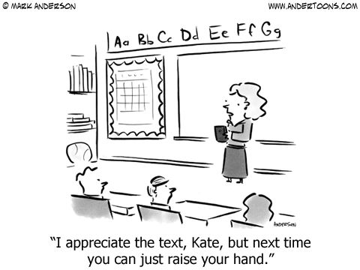
Gaining Attention
When you hear my voice…
Clap Once
Mine is on, yours is off
Raising your hand
Classroom Announcements
Class Calendars
Schoolwide Announcements

Slide 9
Emergency Procedures
Fire Drill
Tornado Drill
Lock Down Drills

Slide 10
Questions, Comments, Concerns??

